Slide 1
Software Testing
Software Engineering

Slide 2
Defect testing
Testing programs to establish the presence of system defects

Slide 3
Objectives
To understand testing techniques that are geared to discover program faults
To introduce guidelines for interface testing
To understand specific approaches to object-oriented testing
To understand the principles of CASE tool support for testing

Slide 4
Topics covered
Defect testing
Integration testing
Object-oriented testing
Testing workbenches

Slide 5
The testing process
Component testing
  Testing of individual program components
  Usually the responsibility of the component developer (except sometimes for critical systems)
  Tests are derived from the developer’s experience
Integration testing
  Testing of groups of components integrated to create a system or sub-system
  The responsibility of an independent testing team
  Tests are based on a system specification

Slide 6
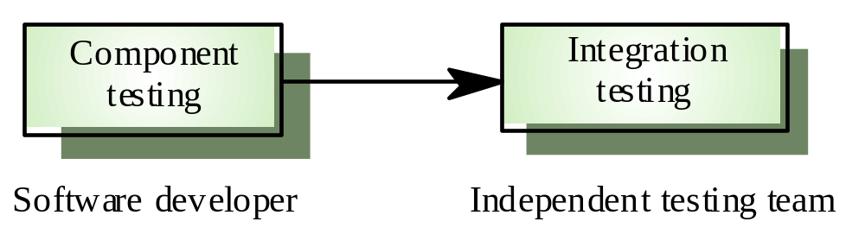
Testing phases

Slide 7
Defect testing
The goal of defect testing is to discover defects in programs
A successful defect test is a test which causes a program to behave in an anomalous way
Tests show the presence not the absence of defects

Slide 8
Testing priorities
Only exhaustive testing can show a program is
free from defects. However, exhaustive testing
is impossible
Tests should exercise a system's capabilities
rather than its components
Testing old capabilities is more important than
testing new capabilities
Testing typical situations is more important than
boundary value cases

Slide 9
Test data and test cases
Test data Inputs which have been devised to
test the system
Test cases Inputs to test the system and the
predicted outputs from these inputs if the
system operates according to its specification

Slide 10
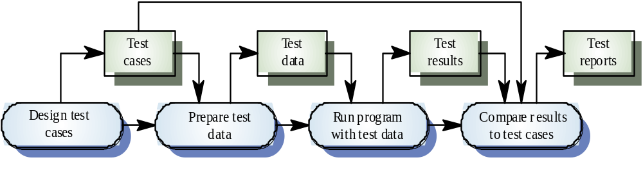
The defect testing process

Slide 11
Black-box testing
An approach to testing where the program is considered as a ‘black-box’
The program test cases are based on the system specification
Test planning can begin early in the software process

Slide 12
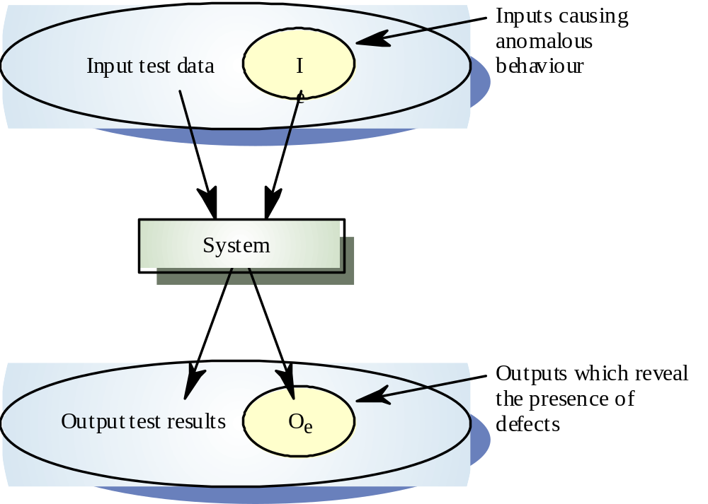
Black-box testing

Slide 13
Equivalence partitioning
Input data and output results often fall into different classes where all members of a class are related
Each of these classes is an equivalence partition where the program behaves in an equivalent way for each class member
Test cases should be chosen from each partition

Slide 14
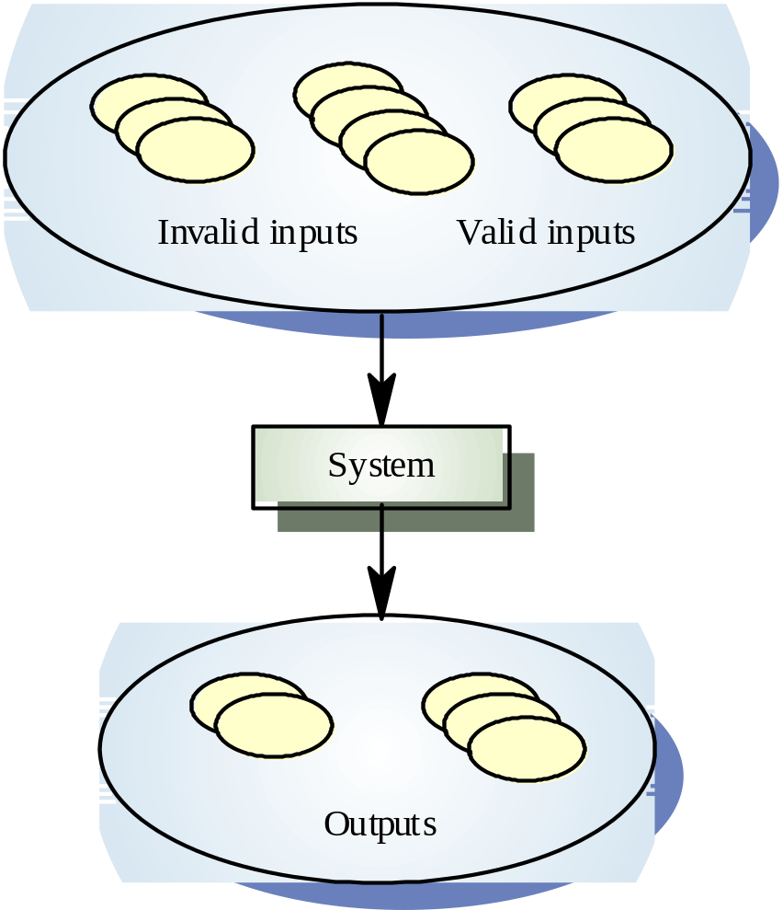
Equivalence partitioning

Slide 15
Equivalence partitioning
Partition system inputs and outputs into
‘equivalence sets’
  If input is a 5-digit integer between 10,000 and 99,999,
  equivalence partitions are <10,000, 10,000-99, 999 and >
  10, 000
Choose test cases at the boundary of these
sets
  00000, 09999, 10000, 99999, 10001

Slide 16
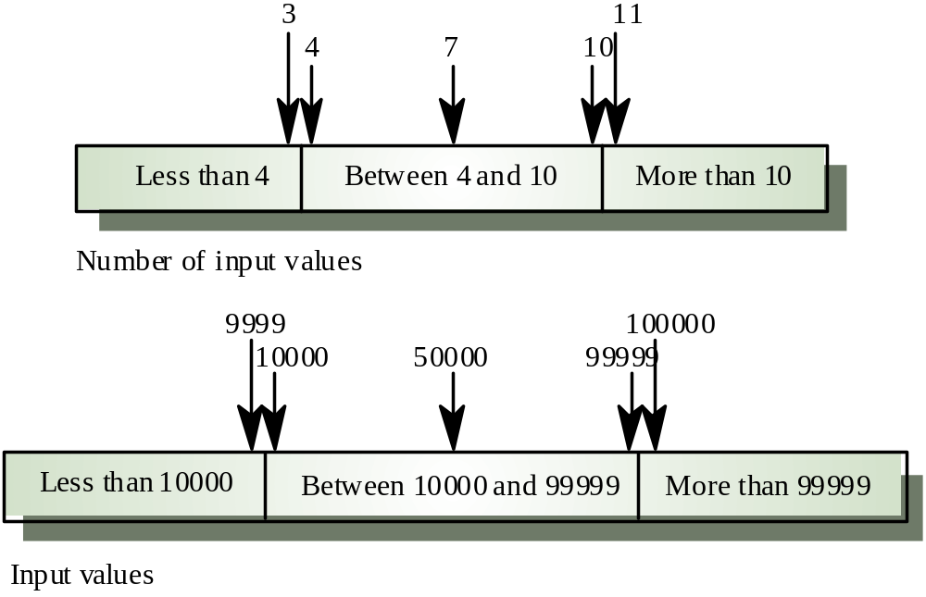
Equivalence partitions

Slide 17
Search routine specification
procedure Search (Key : ELEM ; T: ELEM_ARRAY;
Found : in out BOOLEAN; L: in out ELEM_INDEX) ;
Pre-condition
-- the array has at least one element
T’FIRST <= T’LAST
Post-condition
-- the element is found and is referenced by L
( Found and T (L) = Key)
or
-- the element is not in the array
( not Found and
not (exists i, T’FIRST >= i <= T’LAST, T (i) = Key ))

Slide 18
Search routine - input partitions
Inputs which conform to the pre-conditions
Inputs where a pre-condition does not hold
Inputs where the key element is a member of
the array
Inputs where the key element is not a member
of the array

Slide 19
Testing guidelines (sequences)
Test software with sequences which have only a single value
Use sequences of different sizes in different tests
Derive tests so that the first, middle and last elements of the sequence are accessed
Test with sequences of zero length

Slide 20
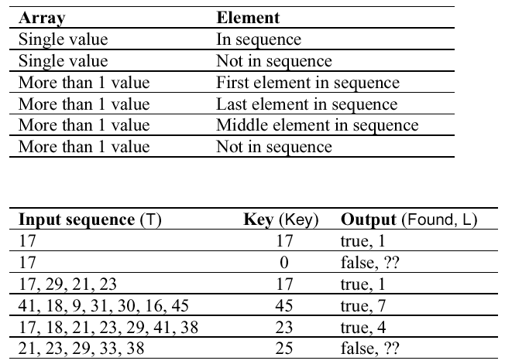
Search routine - input partitions

Slide 21
Structural testing
Sometime called white-box testing
Derivation of test cases according to program
structure. Knowledge of the program is used to identify additional test cases
Objective is to exercise all program statements
(not all path combinations)

Slide 22
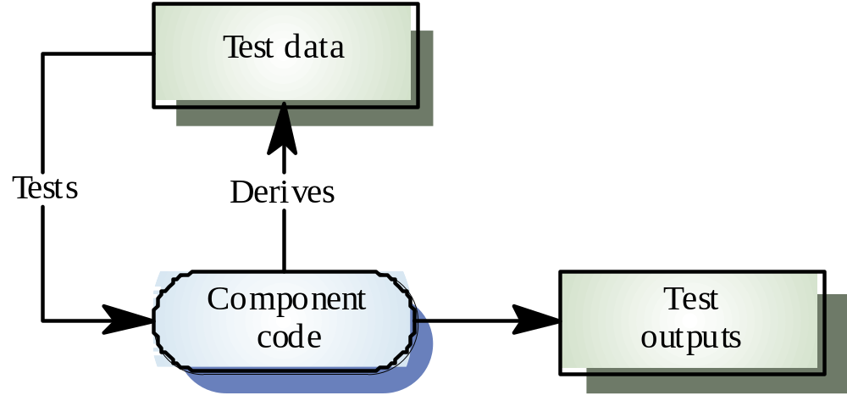
White-box testing

Slide 23
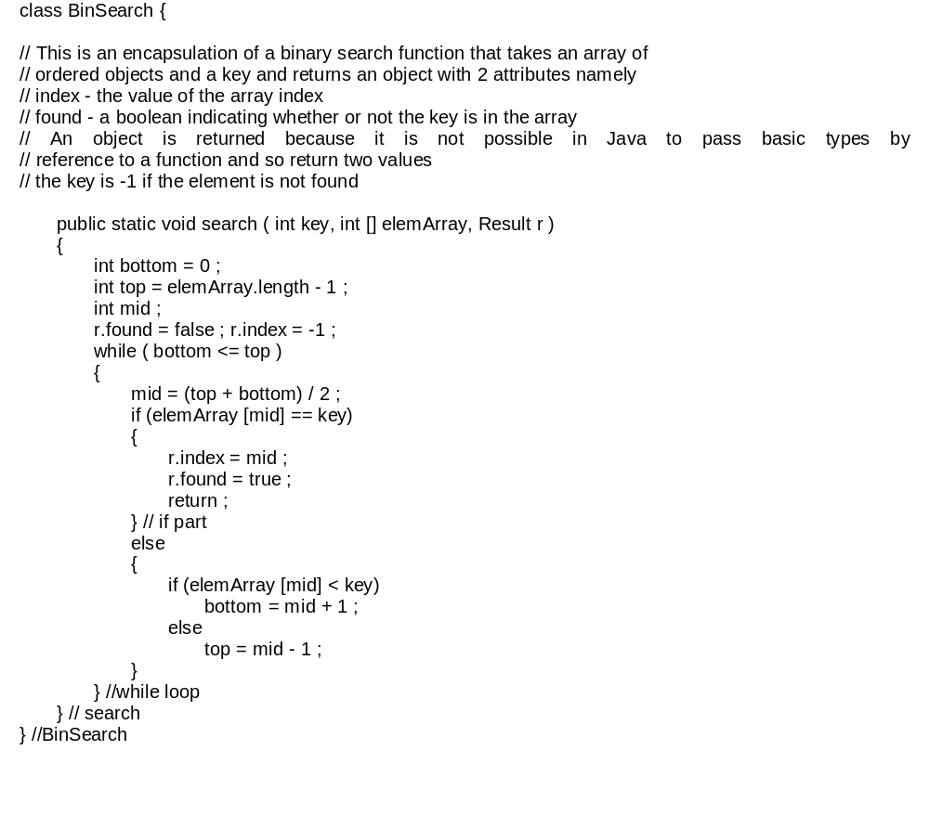
Binary search (Java)

Slide 24
Binary search - equiv. partitions
Pre-conditions satisfied, key element in array
Pre-conditions satisfied, key element not in
array
Pre-conditions unsatisfied, key element in array
Pre-conditions unsatisfied, key element not in array
Input array has a single value
Input array has an even number of values
Input array has an odd number of values

Slide 25
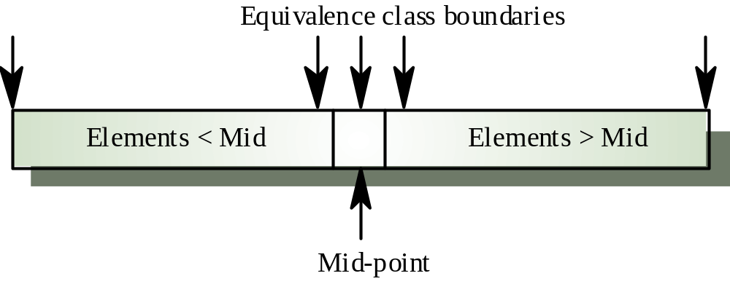
Binary search equiv. partitions

Slide 26
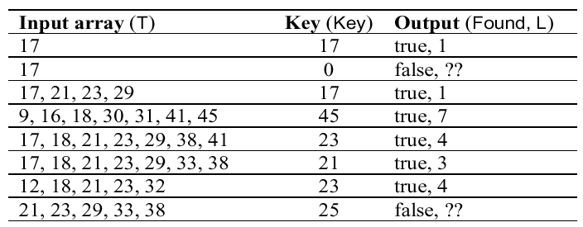
Binary search - test cases

Slide 27
Path testing
The objective of path testing is to ensure that the set of test cases is such that each path through the program is executed at least once
The starting point for path testing is a program flow graph that shows nodes representing program decisions and arcs representing the flow of control
Statements with conditions are therefore nodes in the flow graph

Slide 28
Program flow graphs
Describes the program control flow. Each branch is shown as a separate path and loops are shown by arrows looping back to the loop condition node
Used as a basis for computing the cyclomatic
complexity
Cyclomatic complexity = Number of edges - Number of nodes +2

Slide 29
Cyclomatic complexity
The number of tests to test all control
statements equals the cyclomatic complexity
Cyclomatic complexity equals number of conditions in a program
Useful if used with care. Does not imply
adequacy of testing.
Although all paths are executed, all combinations of paths are not executed

Slide 30
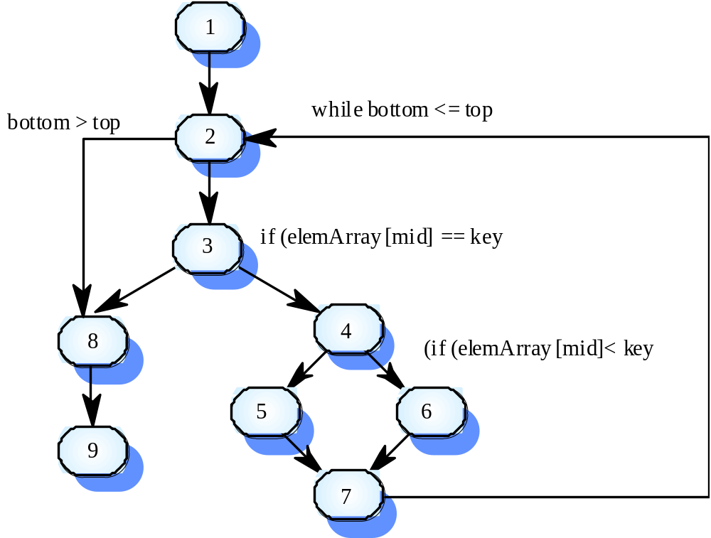
Binary search flow graph

Slide 31
Independent paths
1, 2, 3, 8, 9
1, 2, 3, 4, 6, 7, 2
1, 2, 3, 4, 5, 7, 2
1, 2, 3, 4, 6, 7, 2, 8, 9
Test cases should be derived so that all of these paths are executed
A dynamic program analyser may be used to check that paths have been executed

Slide 32
Integration testing
Tests complete systems or subsystems composed of integrated components
Integration testing should be black-box testing with tests derived from the specification
Main difficulty is localising errors
Incremental integration testing reduces this problem

Slide 33
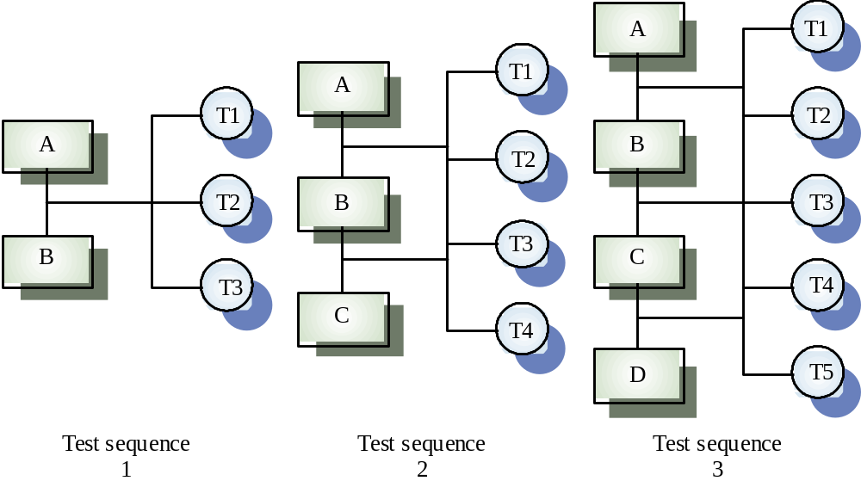
Incremental integration testing

Slide 34
Approaches to integration testing
Top-down testing
  Start with high-level system and integrate from the top-down replacing individual components by stubs where appropriate
Bottom-up testing
  Integrate individual components in levels until the complete system is created
In practice, most integration involves a combination of these strategies

Slide 35
Q: For which types of system is bottom-up testing appropriate,
and why?
Answer:
Object-Oriented Systems – because these have a neat decomposition into classes and methods –makes testing easy
Real-Time Systems – because we can identify slow bits of code more quickly
systems with strict performance requirements – because we can measure the performance of individual methods early in the testing process

Slide 36
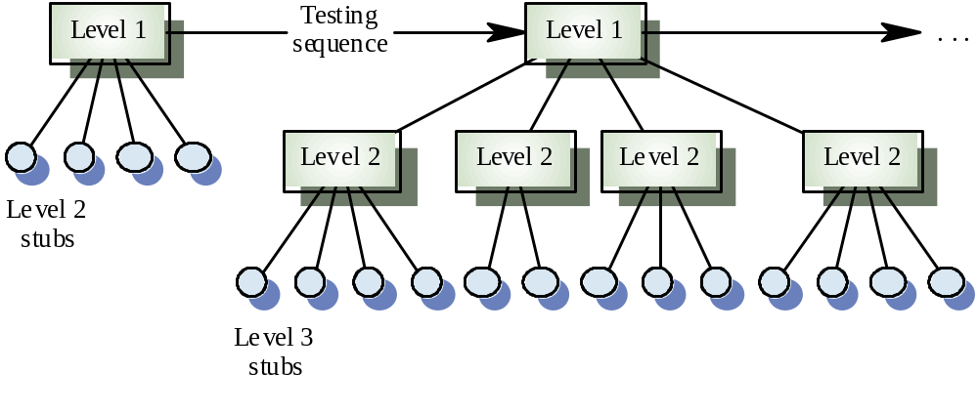
Top-down testing

Slide 37
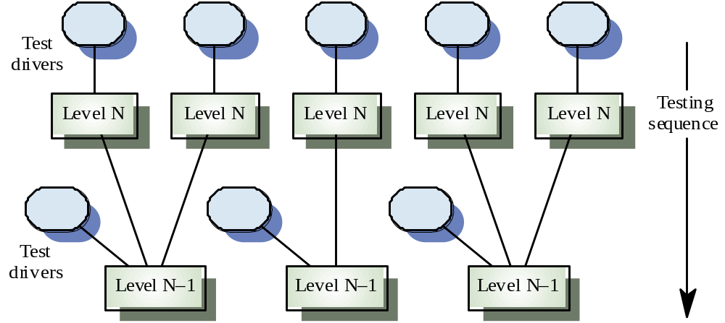
Bottom-up testing

Slide 38
Testing approaches
Architectural validation
  Top-down integration testing is better at discovering errors in the system architecture
System demonstration
  Top-down integration testing allows a limited demonstration at an early stage in the development
Test implementation
  Often easier with bottom-up integration testing
Test observation
  Problems with both approaches. Extra code may be required to observe tests

Slide 39
Interface testing
Takes place when modules or sub-systems are integrated to create larger systems
Objectives are to detect faults due to interface errors or invalid assumptions about interfaces
Particularly important for object-oriented development as objects are defined by their interfaces

Slide 40
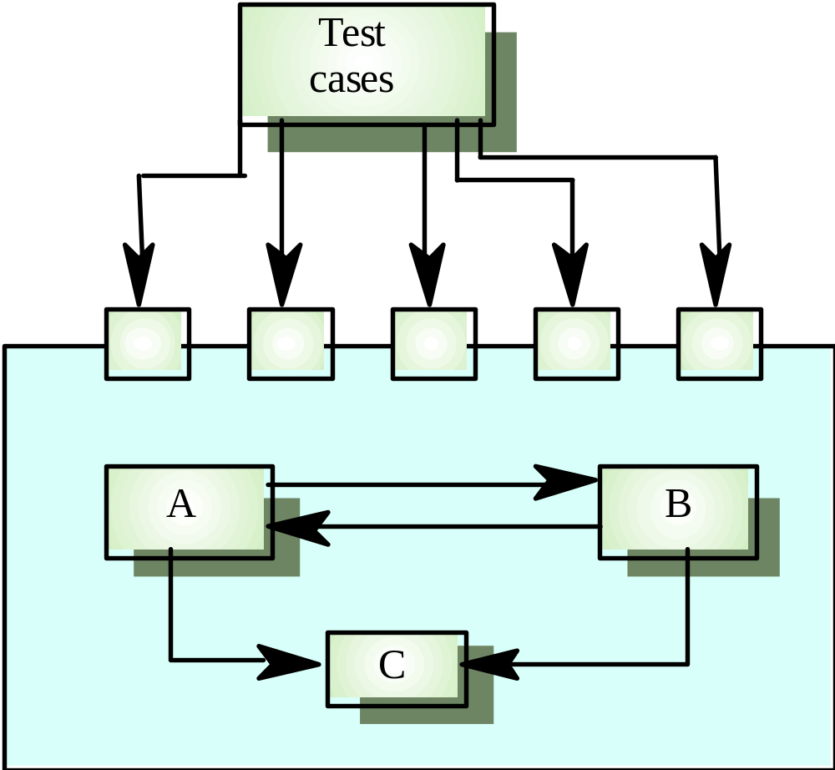
Interface testing

Slide 41
Interfaces types
Parameter interfaces
  Data passed from one procedure to another
Shared memory interfaces
  Block of memory is shared between procedures
Procedural interfaces
  Sub-system encapsulates a set of procedures to be called by other sub-systems
Message passing interfaces
  Sub-systems request services from other sub-systems

Slide 42
Interface errors
Interface misuse
  A calling component calls another component and makes an error in its use of its interface e.g. parameters in the wrong order
Interface misunderstanding
  A calling component embeds assumptions about the behaviour of the called component which are incorrect
Timing errors
  The called and the calling component operate at different speeds and out-of-date information is accessed

Slide 43
Interface testing guidelines
Design tests so that parameters to a called procedure are at the extreme ends of their ranges
Always test pointer parameters with null pointers
Design tests which cause the component to fail
Use stress testing in message passing systems
In shared memory systems, vary the order in which components are activated

Slide 44
Stress testing
Exercises the system beyond its maximum design load. Stressing the system often causes defects to
come to light
Stressing the system test failure behaviour.. Systems should not fail catastrophically. Stress testing checks for unacceptable loss of service or data
Particularly relevant to distributed systems
which can exhibit severe degradation as a
network becomes overloaded

Slide 45
Object-oriented testing
The components to be tested are object classes that are instantiated as objects
Larger grain than individual functions so approaches to white-box testing have to be extended
No obvious ‘top’ to the system for top-down integration and testing

Slide 46
Testing levels
Testing operations associated with objects
Testing object classes
Testing clusters of cooperating objects
Testing the complete OO system

Slide 47
Object class testing
Complete test coverage of a class involves
  Testing all operations associated with an object
  Setting and interrogating all object attributes
  Exercising the object in all possible states
Inheritance makes it more difficult to design object class tests as the information to be tested is not localised

Slide 48
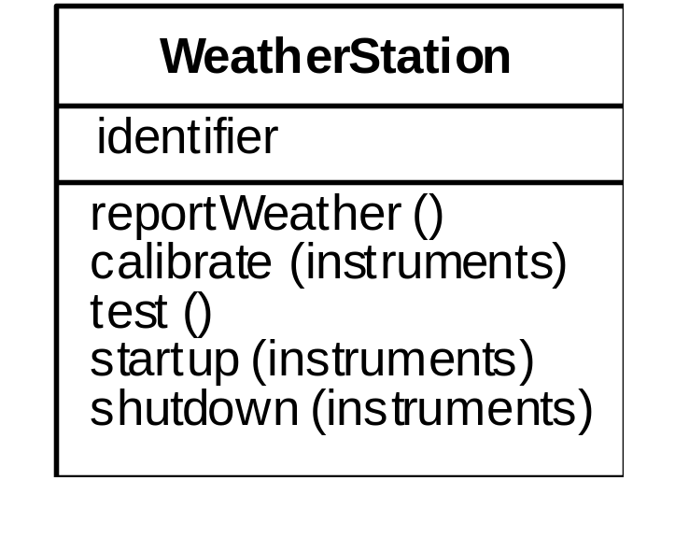
Weather station object interface
Test cases are needed for all operations
Use a state model to identify state transitions for testing
Examples of testing sequences
  Shutdown → Waiting → Shutdown
  Waiting → Calibrating → Testing → Transmitting → Waiting
  Waiting → Collecting → Waiting → Summarising → Transmitting → Waiting

Slide 49
Object integration
Levels of integration are less distinct in object-oriented systems
Cluster testing is concerned with integrating and testing clusters of cooperating objects
Identify clusters using knowledge of the operation of objects and the system features that are implemented by these clusters

Slide 50
Approaches to cluster testing
Use-case or scenario testing
  Testing is based on a user interactions with the system
  Has the advantage that it tests system features as experienced by users
Thread testing
  Tests the systems response to events as processing threads through the system
Object interaction testing
  Tests sequences of object interactions that stop when an object operation does not call on services from another object

Slide 51
Scenario-based testing
Identify scenarios from use-cases and supplement these with interaction diagrams that show the objects involved in the scenario
Consider the scenario in the weather station system where a report is generated

Slide 52
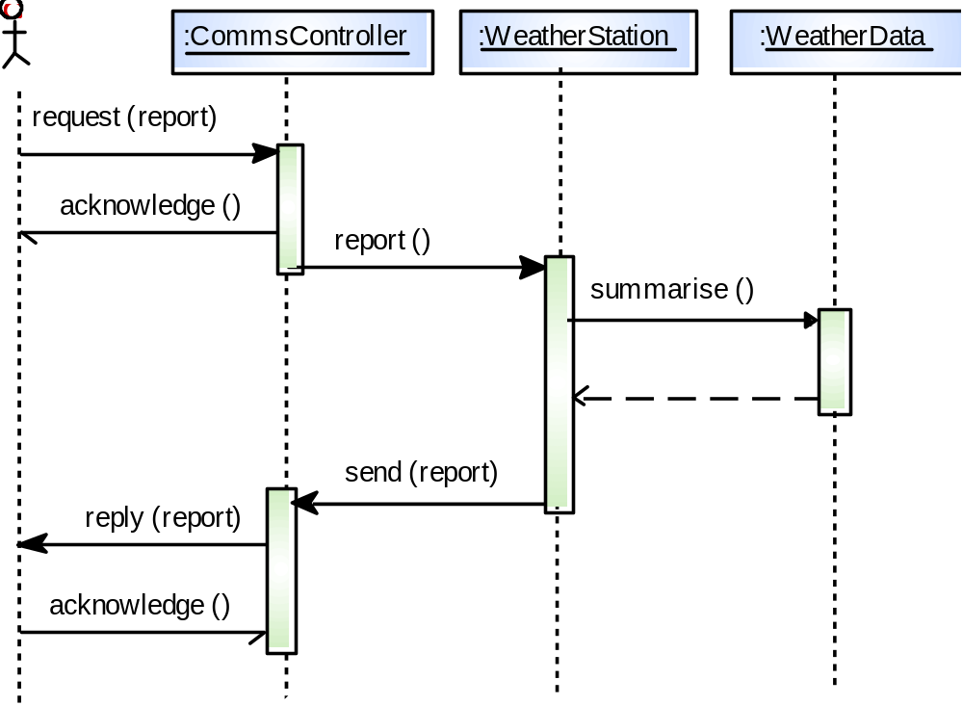
Collect weather data

Slide 53
Weather station testing
Thread of methods executed
  CommsController:request → WeatherStation:report → WeatherData:summarise
Inputs and outputs
  Input of report request with associated acknowledge and a final output of a report
  Can be tested by creating raw data and ensuring that it is summarised properly
  Use the same raw data to test the WeatherData object

Slide 54
Testing workbenches
Testing is an expensive process phase. Testing workbenches provide a range of tools to reduce the time required and total testing costs
Most testing workbenches are open systems because testing needs are organisation-specific
Difficult to integrate with closed design and analysis workbenches

Slide 55
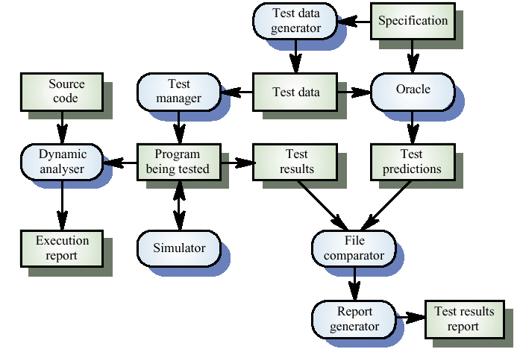
A testing workbench

Slide 56
Testing workbench adaptation
Scripts may be developed for user interface simulators and patterns for test data generators
Test outputs may have to be prepared manually for comparison
Special-purpose file comparators may be developed

Slide 57
Key points
Test parts of a system which are commonly used rather than those which are rarely executed
Equivalence partitions are sets of test cases where the program should behave in an equivalent way
Black-box testing is based on the system specification
Structural testing identifies test cases which cause all paths through the program to be executed

Slide 58
Key points
Test coverage measures ensure that all statements have been executed at least once.
Interface defects arise because of specification misreading, misunderstanding, errors or invalid timing assumptions
To test object classes, test all operations, attributes and states
Integrate object-oriented systems around clusters of objects

